Slide 1



Web Science Application Development

Slide 2
Next Parts of Class
Core Engineering Pillars
Authentication & Authorization
Testing (Unit & Integration)
Deployment (Architecture & CI/CD Pipelines)
Agentic Systems (LangChain & Tooling)
In Parallel, We Will:
Deepen our understanding of React fundamentals and patterns
Compare and evaluate modern web frameworks (e.g., Flask)
Connect architectural decisions to real-world tradeoffs

Slide 3
Readings - Testing
- [Web Application Testing for QA Teams: A Step-by-Step Guide](https://www.virtuosoqa.com/post/testing-web-applications)
- [Jest Documentation](https://jestjs.io/docs/getting-started)
- [Supertest Documentation](https://github.com/ladjs/supertest)
- [Playwright Testing Documentation](https://playwright.dev/docs/intro)
- [Testing Pyramid (Martin Fowler)](https://martinfowler.com/articles/practical-test-pyramid.html)
- [Google Testing Blog](https://testing.googleblog.com/)
- [Cypress vs Playwright Comparison](https://www.cypress.io/blog/cypress-vs-playwright)

Slide 4
How do we know our code actually works?

Slide 5
Why Testing Matters
Ensures reliability
Prevents regressions
Improves code quality
Enables faster, reliable development
Without testing, can’t make changes without breaking things

Slide 6
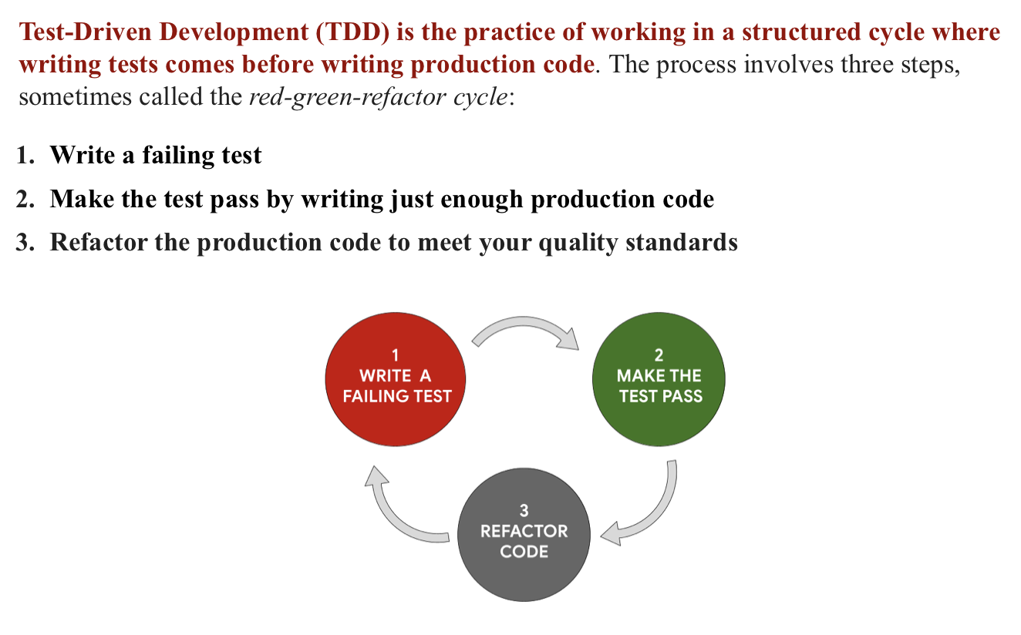
Test-Driven Development
Particularly Important in the age of AI

Slide 7
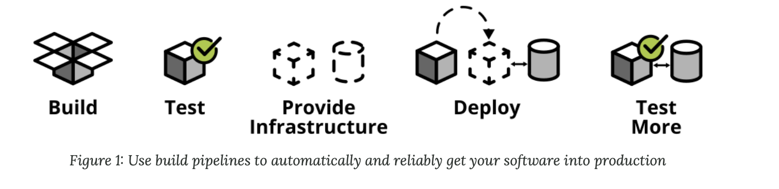
Testing Functionality and Deployments
Source: https://martinfowler.com/articles/practical-test-pyramid.html

Slide 8
Types of Tests
Unit Tests
Test a single function in isolation
Example: does bcrypt.hash() produce a valid hash?
Fast — run hundreds in seconds
Integration Tests
Test components working together
Example: does POST /api/register actually store a user?
Slower — may need a running server or database
End-to-End (E2E) Tests
Test the full user flow from client to server
Example: register → login → access protected route
Slowest — but catches real-world bugs

Slide 9
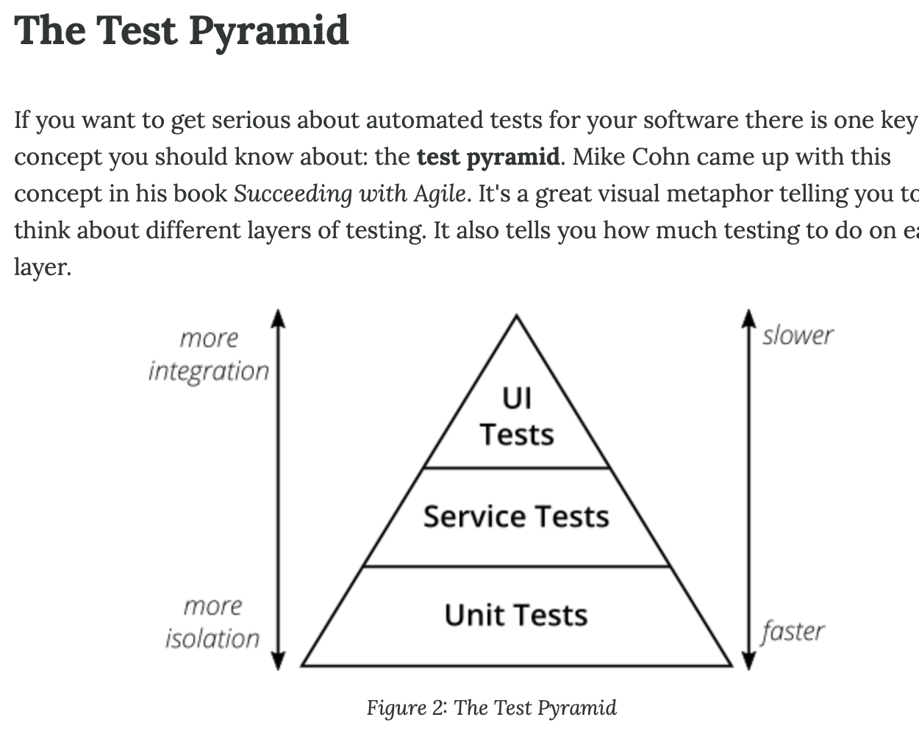
The Testing Pyramid

Slide 10
Testing in the Demo Repo
27 tests across 3 layers, all in the same repo
12 unit tests (Jest) - test pure utility functions
10 integration tests (Supertest) - test API endpoints
5 E2E tests (Playwright) - test full browser flows
What the tests cover:
Input validation (valid, invalid, edge cases, null)
Registration, login, and auth token flow
Protected routes (no token, valid token, invalid token)
Full UI: register, login, access secret, logout
Key idea: tests document expected behavior
If the tests pass, the API contract is met

Slide 11
Automated Testing & CI/CD
CI = Continuous Integration
Every push triggers automated tests
Catch bugs before they reach production
GitHub Actions runs our autograder on every push
CD = Continuous Deployment
If tests pass, deploy automatically
If tests fail, block the deployment
Why this matters:
Manual testing doesn't scale
Automated tests give confidence to ship fast
Tests are a safety net — not a replacement for good design

Slide 12
Testing Frameworks Overview
Demo of Unit, Integration, and End-to-End testing
Node.js / Express JWT App

Slide 13
Testing Layers
• Unit: test functions
• Integration: test APIs
• E2E: test full user flow

Slide 14
Unit Testing (Jest)
Fast (ms) - Tests isolated functions with no dependencies
Example from utils.test.js:
test('rejects short password', () => {
const result = validateCredentials('alice', '123');
expect(result.valid).toBe(false);
});
No server, no database, no network - just function in, result out
Covers: valid inputs, invalid inputs, edge cases, null handling

Slide 15
Integration Testing (Supertest)
Medium speed - Tests API routes and middleware together
Example from api.test.js (using Supertest):
test('registers a new user', async () => {
const res = await request(app)
.post('/api/register')
.send({ username: 'alice', password: 'pass123' });
expect(res.status).toBe(201);
});
Supertest makes HTTP requests without starting a real server
Verifies status codes, response bodies, auth flow

Slide 16
End-to-End Testing (Playwright)
Slower (seconds) - Tests full app in a real Chromium browser
Example from auth.spec.js (using Playwright):
test('can register and login', async ({ page }) => {
await page.locator('input[type="text"]')
.fill('alice');
await page.locator('button').click();
await expect(page.locator('.success'))
.toBeVisible();
});
Fills forms, clicks buttons, asserts on visible page content
Catches real-world bugs that unit/integration tests miss

Slide 17
Project Structure
server.js # Express app with JWT auth
utils.js # Pure functions (unit test targets)
public/index.html # React frontend
playwright.config.js # E2E test config
tests/
unit/utils.test.js # Jest unit tests
integration/api.test.js # Supertest API tests
e2e/auth.spec.js # Playwright browser tests

Slide 18
Running Tests
npm test Unit + Integration (Jest)
npm run test:unit Unit tests only
npm run test:integration API tests only
npm run test:e2e Browser tests (Playwright)
npm run test:all Everything

Slide 19
Try It - GitHub Codespaces
Open the demo repo in Codespaces:
Go to the repo on GitHub
Click the green Code button, then Codespaces tab
Click “Create codespace on main”
Everything is pre-configured:
Node.js 20 + npm dependencies auto-installed
Playwright browsers auto-installed
VS Code extensions for Jest and Playwright
Run all tests immediately:
npm run test:all

Slide 20
What Test Output Looks Like
Jest (Unit + Integration):
PASS tests/unit/utils.test.js
validateCredentials
✓ accepts valid username and password (2 ms)
✓ rejects missing username (1 ms)
✓ rejects short password (< 6 characters)
Tests: 22 passed, 22 total | Time: 0.98s
Playwright (E2E):
✓ page displays the title and login status (868ms)
✓ can register, login, and access the secret (1.3s)
✓ logout clears the session (1.1s)
5 passed (5.8s)

Slide 21
Exercise: Write Your Own Tests (ungraded)
Add one new test to each layer. See the README for hints and solutions.
1. Unit Test
Test validateCredentials with a whitespace-only username
Does the current code handle this? If not, fix the bug!
2. Integration Test
Test that /api/refresh returns a new access token after login
3. E2E Test
Test that registering a duplicate username shows an error in the UI
Verify: npm run test:all

Slide 22
Key Takeaways
Use all 3 testing layers
Unit tests catch logic bugs fast; integration tests verify APIs; E2E tests catch real user-facing bugs
Balance speed vs realism
More unit tests (fast), fewer E2E tests (slow but realistic)
Automate testing in your workflow
CI/CD runs tests on every push - catch bugs before production
Tests document expected behavior
If the tests pass, the API contract is met

